Slide 1
ERROR HANDLING IN PHP
Notes:
1

Slide 2
ERROR HANDLING
While creating script or web applications error handling is an important part.
Error handling is a process of caching error raised by your program and then taking appropriate action.
Notes:
2

Slide 3
PHP ERROR HANDLING
Php offers a number of ways to handle errors
1. Die statements-
2. custom error handlers-
3.php error reporting-
Notes:
3

Slide 4
Die( ) function
Die function combines the echo and exit function in one.
It is very useful when we want to output a message and stops the script execution when an error occurs.
eg.
<?php
$f=fopen(“test.txt”,”r”);
?>
if the file does not exist shows an error:
Warning :fopen(test.txt)[function.fopen]:failed to open stream:
No such file directory in C:\webfolder\test.php on line 2
Notes:
4

Slide 5
<?php
if(!file_exists(“test.txt”)){
die(“File not found”);
}else{
$f=fopen(“test.txt”,”r”);
}
?>
Output
File not found
The code is more consistent than the earlier code.
Notes:
5

Slide 6
Custom error handling function
These are user defined functions that are called whenever an error occurs.
Php provides a framework to define error handling functions
The function can be able to handle a minimum of two parameters(error level and error message) but can accept up to five parameters (optionally:file,line-numbers,and the error context)
Syntax
error_function(error_level, error_message, error_file, error_line, error_context);
Notes:
6

Slide 7
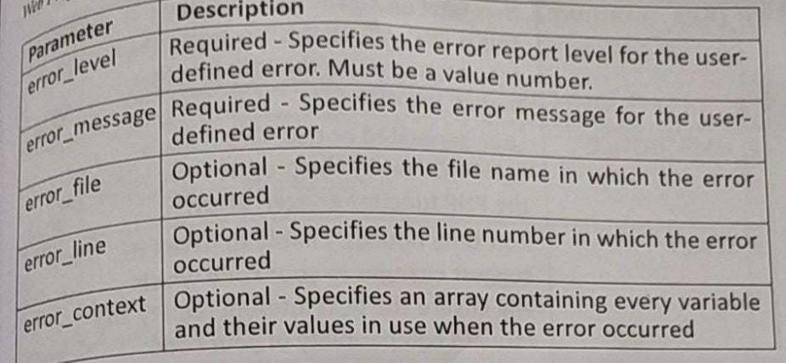
Notes:
7

Slide 8
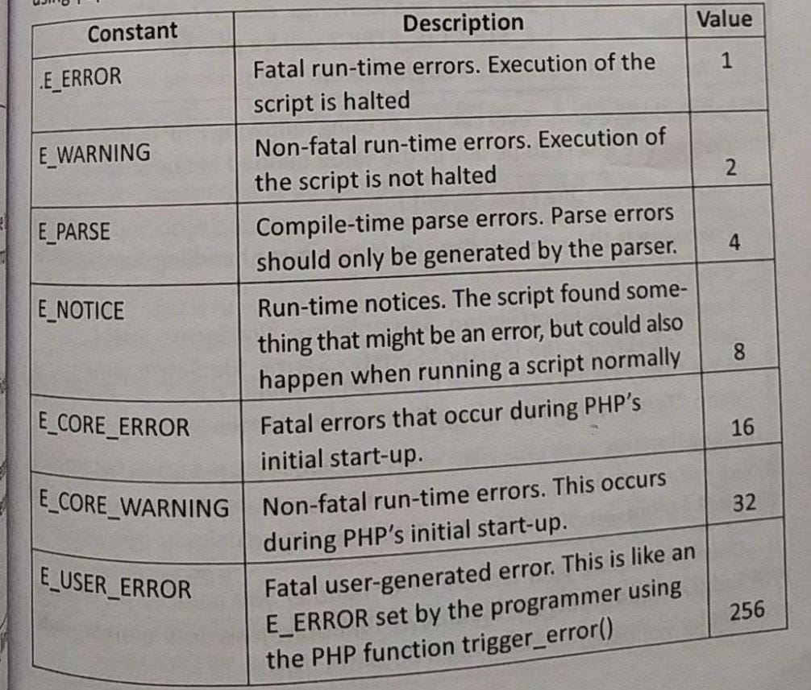
Error levels
Notes:
8

Slide 9
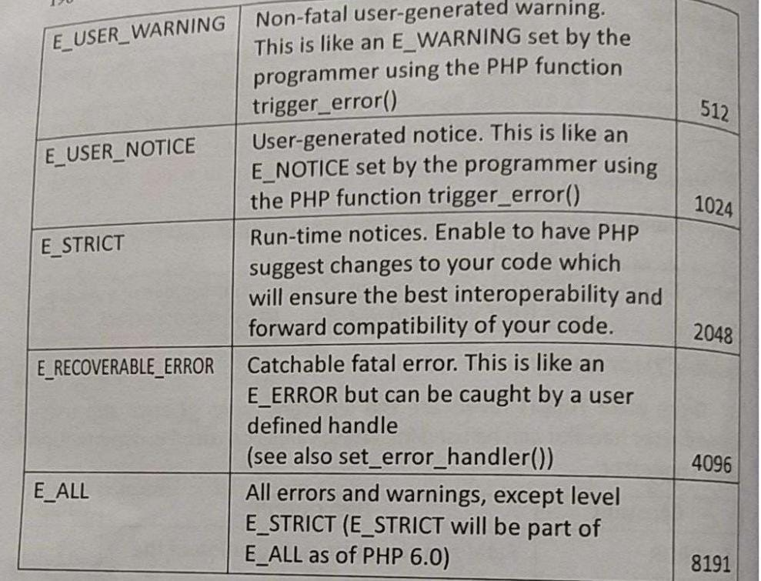
Notes:
9

Slide 10
<?php
functionhandleError($errno,$errstr,$error_file,$error_line,){
echo “<b>Error:</b>[$errno] $errstr -$error_file:$error_line”;
echo”<br/>”;
echo “Terminating PHP script”;
die();
}
?>
Notes:
10

Slide 11
<?php
error_reporting(E_ERROR);
functionhandleError($errno,$errstr,$error_file,$error_line,)
{
echo “<b>Error:</b>[$errno] $errstr -$error_file:$error_line”;
echo”<br/>”;
echo “Terminating PHP script”;
die();
}
//set error handler
set_error_handler(“handleError”);
//trigger error
myFunction();
?>
Notes:
11

Slide 12
Exception Handling
Exceptions are important and provides a better control over error handling.
1.Try- a function using an exception should be in a try block.if the exception does not triger,the code will continue as normal. However if an exception triggers, an exception is “thrown”.
2.Throw -“this is how you trigger an exception each throw must have atleast one “catch”.
3.catch- a catch block retrieves an exception and creates an object containing the exception information
If an exception is not caught a PHP Fatal Error will be issued with an Uncaught Exception ...
1.an exception can be thrown, and caught within PHP Code may be surrounded in a try block.
2.Each try must have atleast one corresponding catch block Multiple catch blocks can be used to catch diffferent classes of exception.
3.Exception can be thrown within a catch block.
Notes:
12

Slide 13
<?php
try {
$error =’always throw this error’;
throw new Exception ($error);
//code following an exception is not executed.
Echo ‘Never executed’;
}catch (Exception $e){
echo ‘Caught exception’, $e->getMessage(),”\n”;
}
//countinue execution
echo “HELLO WORLD”,
?>
output
Caught exception always throw this error HELLO WORLD
Notes:
13

Slide 14
The functions that can be used from Exception class
1.getMessage()” message of exception
2.getCode()” code of exception
3.getFile()” source filename
4.getLine()” source line
5.getTrace()” n array of the backtrace()
6.getTraceAsString()” formatted string of trace
Notes:
14

Slide 15
Creating custom Exception handler
Exception handler is the name of the function to be called when an uncaught exception occurs.
Function must be defined before calling set_exception _handler().
eg
<?php
functionexception_handler($exception){
echo “Uncaught exception: ” .$exception->getMessage(),”\n”;
}
set_exception_handler(‘exception_handler’);
throw new Exception (‘Uncaught Exception’);
echo “Not Executed\n”;
?>
Notes:
15

Slide 16
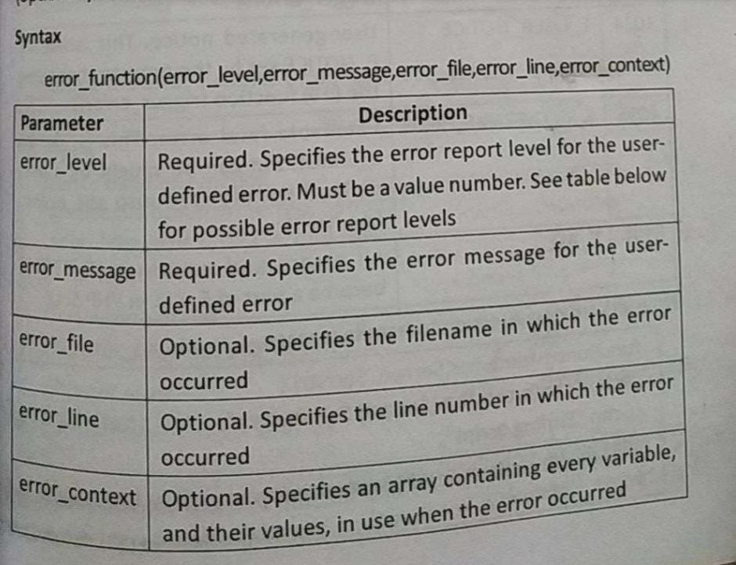
Notes:
16

Slide 17
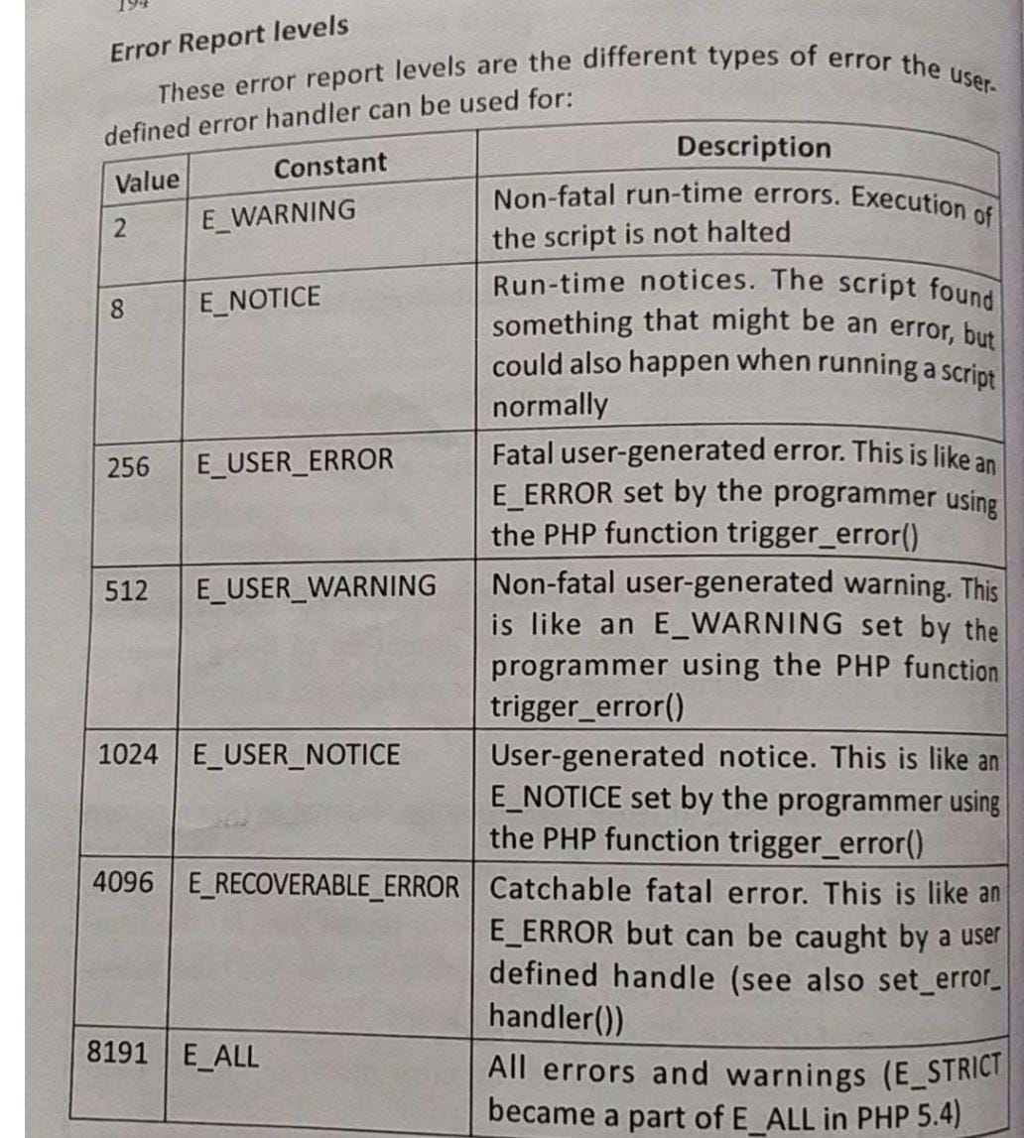
Error reporting levels
Notes:
17

Slide 18
Set Error Handler
Eg. testing the error handler by trying to output variable that does not exist:
<?php
//error handler function
functioncustomError($errno,$errstr) {
echo “<b>Error:</b>[$errno]$errstr”;
}
//set error handler
set_error_handler(“customError”);
//trigger error
echo($test);
?>
output
Error:[8] Undefined variable: test
Notes:
18

